Slide 1


INDIAN INSTITUTE OF INFORMATION TECHNOLOGY, LUCKNOW
Real Time Gesture Based Paint Application
Group Members :
Chetan Joshi LIT2017010
Hidayat Ullah Khan LIT2017029
Gaurav Singh LIT2017031
Supervisor :
Dr. Deepak Singh

Slide 2


Introductory Information
A paint program is a software graphics program that allows the user to draw or paint bitmapped images on a computer.

Slide 3
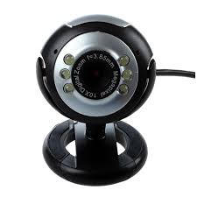

Aim Of the Project
The Aim of this project is to make the process of painting more user friendly by using webcam of computer to track the motion of an object and use it as paint brush.

Slide 4


How It Works ?
Given the real time webcam data, this paint-like python application uses OpenCV library to track an object of interest and allows the user to draw by moving the object, which makes it both awesome and challenging to draw simple things.
+

Slide 5

This project allows user to draw on screen with full ease using real time hand gestures. The application also allows user to switch between brush size and paint colours. It also contains many other features.
Salient Features

Slide 6
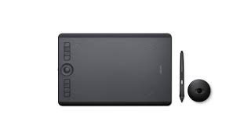


Why We Need This Project ?
In current scenario MS Paint or different paint software’s are used for editing or drawing images on screen with traditional pointing devices. For editing image or drawing shape user do not have any other option except keyboard mouse to use paint software.

Slide 7
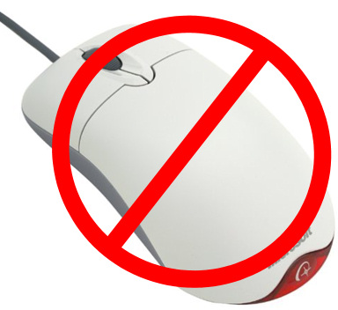
How It Reduces Cost ?
As device or hardware interface is required to use software which impacts on cost of the project or system. So to avoid this we are proposing a Smart paint software which can be used without any hardware interface.

Slide 8

Motivation For The Project
Hand gestures are best way to communicate with computer system. Almost all paint programs are more or less similar on the basis of their functionality and the way user gives input.
This gives EDGE to our project.

Slide 9
Features Of Real Time Gesture Based Paint Application

Slide 10
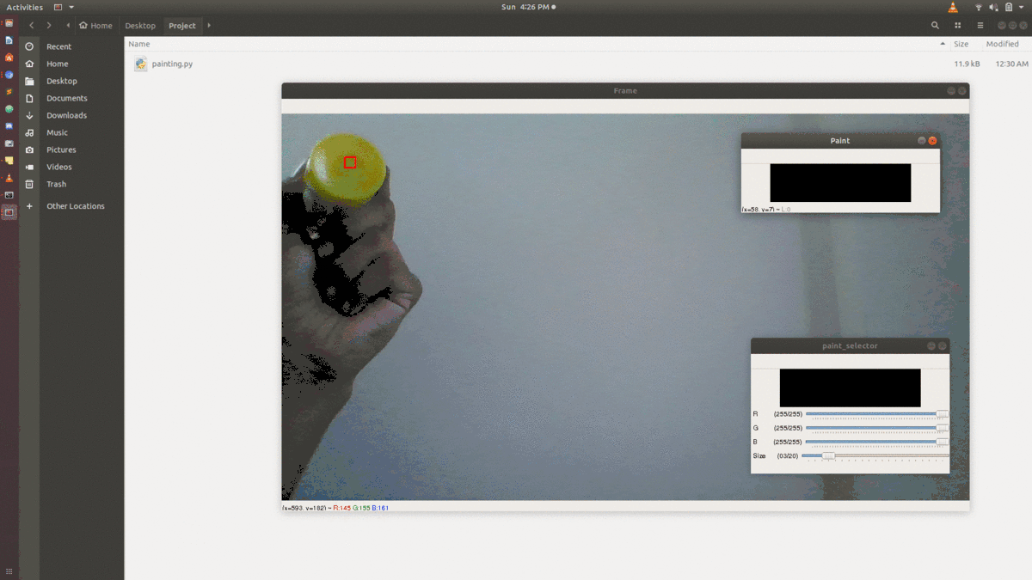
1. Freedom To Choose Any Object For Drawing

Slide 11
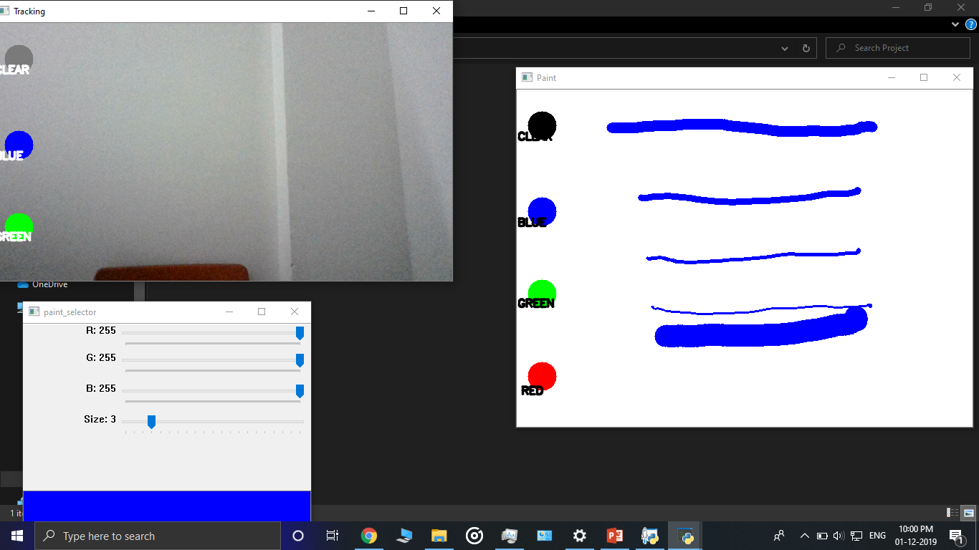
2.Choose From Different Brush Sizes

Slide 12
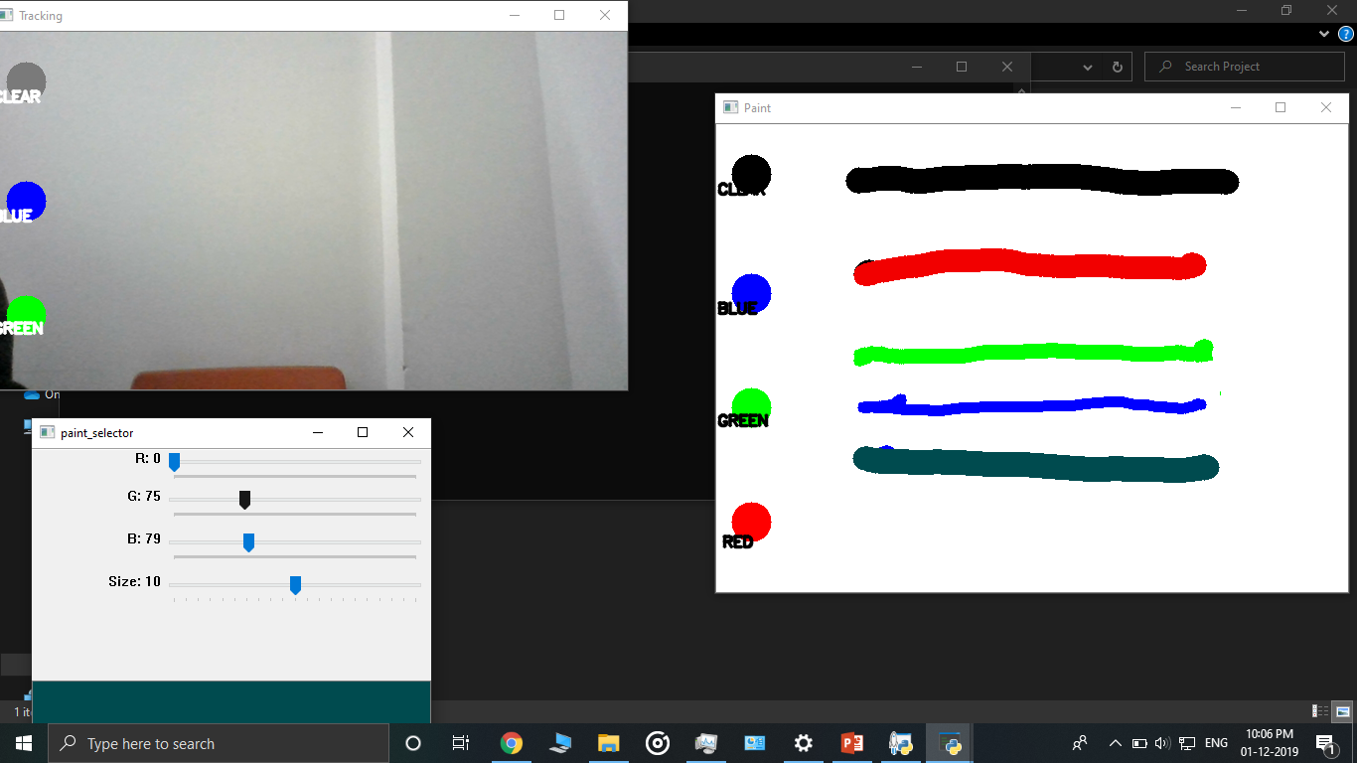
3.Large Variety Of Color Range

Slide 13
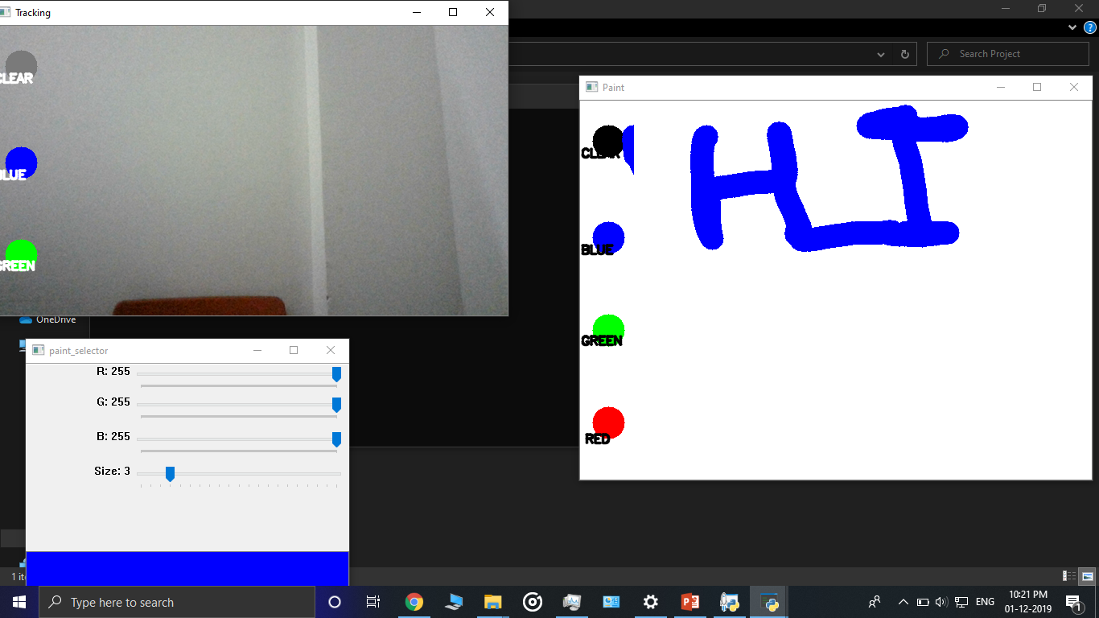
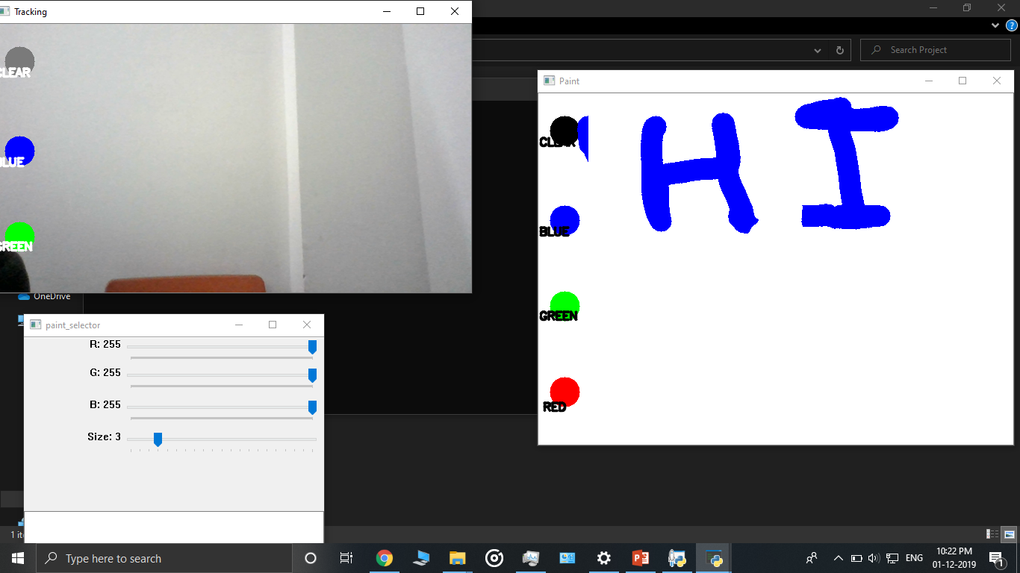
4.On Demand Eraser Tool
>
BEFORE
AFTER

Slide 14

5. Mouse Pointer

Slide 15
5. Save Painting

Slide 16
5.KeyBoard Controls
S - Enable/Disable Brush
M – Increase Brush Size
N – Decrease Brush Size
P – Save The Drawing
Q – Quit The Application
L – Choose Color From Color Slider

Slide 17
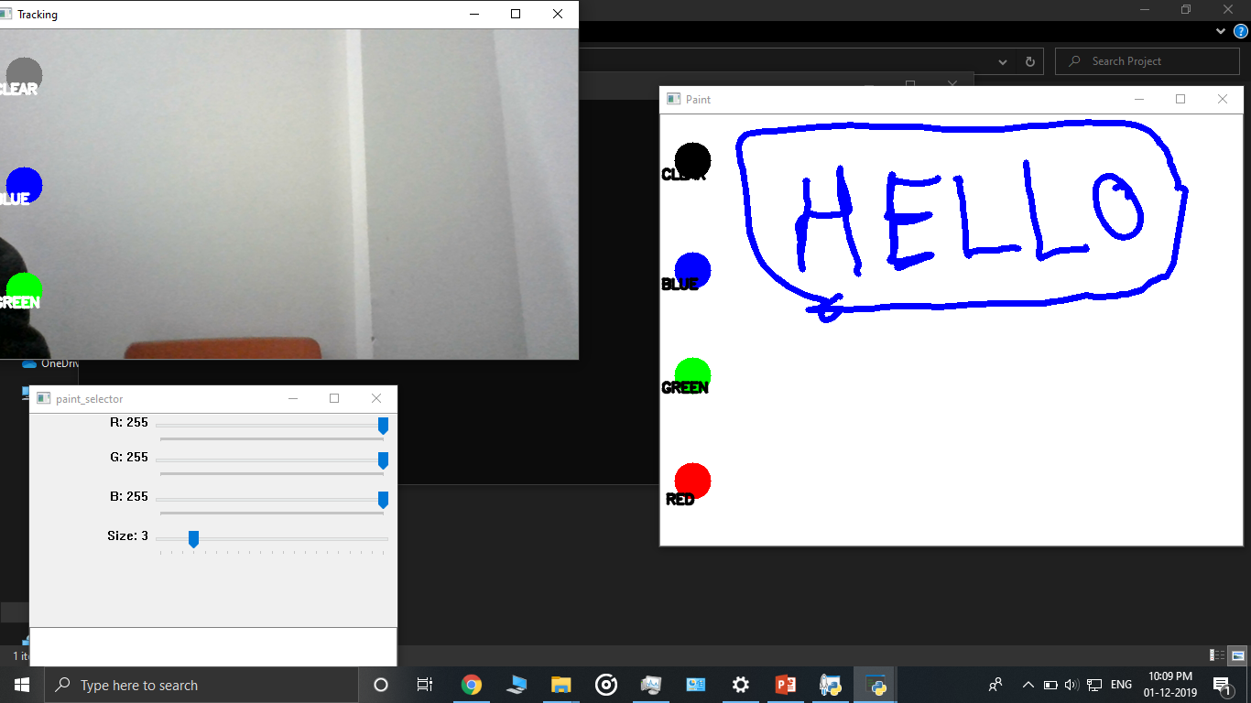
Demo Illustration Of Project

Slide 18
{ CODE }
EXPLANATION

Slide 19
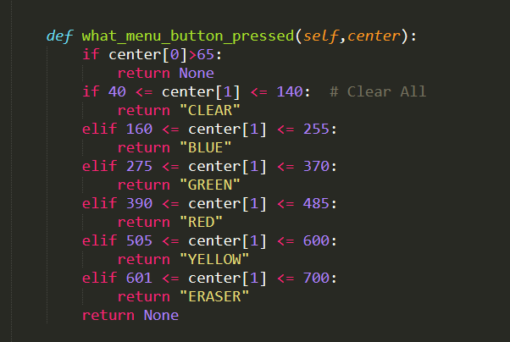
1. SELECTION OF COLORS/CLEAR BUTTON/ERASER

Slide 20
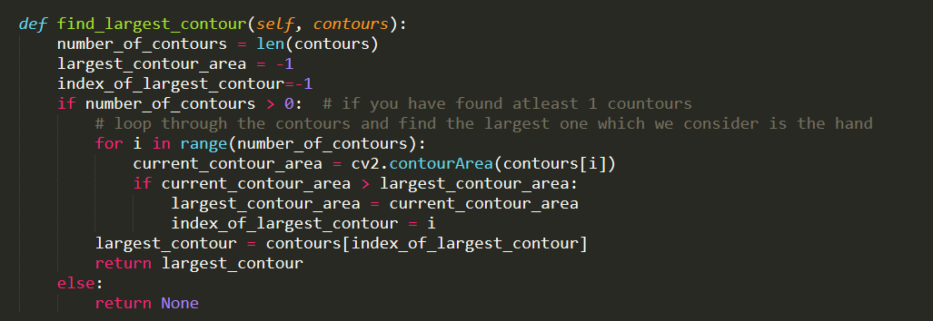
2. FINDING LARGEST CONTOUR OF ALL CONTOURS

Slide 21
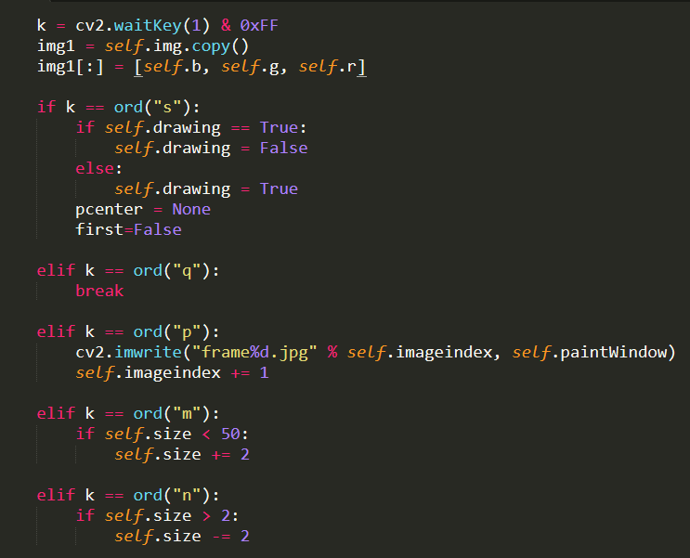
3. KEY MAPPINGS FOR VARIOUS FUNCTIONS

